Slide 1
Deep Dive on Extended Planning

Slide 2
Extended Planning
Observed Trends: Following the increased need for operational /business-led plans, FP&A teams are transitioning from being internal consultants to enablers, democratizing the FP&A function by equipping business users in the field with tools and data to take ownership of their own planning process
Common Challenges: Finance operations need to rely more on the participation and inputs of field teams with strong business expertise and less financial acumen making technology–centric business partnering a priority for FP&A teams.
Perceived Risks: data accuracy due additional operational inputs & increased demand for local agility without compromising global governance
MARKET INSIGHTS

Slide 3

CCH Tagetik Extended Planning
Extending beyond traditional financial planning & analysis to include operational and strategic areas for increased cross-functional alignment in a unified, AI-powered intelligent platform
g
g
Financial Planning
Operational Planning
Long Range Planning
Annual Budgeting
Rolling Forecasts
Revenue Planning
Opex Planning
Capital Planning
Balance Sheet Planning
Cash Flow Planning
….
Sales & Margin Planning
Material Cost Planning
Demand Planning
Supply Chain Planning
Workforce Planning
Project Planning
IT & Marketing Planning
ESG Planning
…
Extended Planning
Scenario Planning
Advanced Modeling
ZBB & Driver Based
Top Down & Bottom up
AI Predictive Models
Reporting & Analytics
Notes:
Key Features of Extended Planning:
Cross-functional Integration:
Extended planning breaks down silos by connecting finance with other departments like operations, HR, sales, and marketing. This ensures that all planning activities are aligned with the organization’s strategic goals.
Unified Platform:
Extended planning often leverages a single platform or ecosystem that allows for consistent data, processes, and collaboration across all planning activities.
Real-time Data and Analytics:
By incorporating real-time data, extended planning enables organizations to adapt quickly to changes in the market, improve forecasting accuracy, and make informed decisions.
Scenario Planning:
It provides tools to simulate different scenarios across various operational areas, helping organizations prepare for uncertainties and align financial impacts.
AI and Automation:
Advanced technologies like artificial intelligence, machine learning, and automation play a key role in improving accuracy, reducing manual work, and enabling predictive analytics in extended planning.
Collaboration and Accountability:
Extended planning encourages input and accountability from teams across the organization, empowering individuals in the field to take ownership of their plans while maintaining alignment with overall company objectives.

Slide 4
CCH Tagetik Extended Planning helps Finance Organizations:
Increase forecast Accuracy
Gain Flexibility
Get deeper insights
Accurate forecasts
Get the flexibility to plan your way
In-depth planning, modeling and analysis
Reduce Uncertainty - get more accurate forecasts with predictive planning and forecasting
Real-time Visibility – with real-time progress reports, dashboards & scorecards and iterative reporting
Future ready – Process high volumes of data for use in AI, ML, predictive analytics
Flexible Planning - Plan any way: top-down , bottom-up, zero or driver-based Planning, over any time horizon: Long-range, Annual Budgets, Monthly, Quarterly & Rolling Forecasts
Comprehensive Planning - From Strategic, Financial and Operational to Industry & Department Specific Planning
Plan Smarter & Faster - Centralized built-in financial intelligence, Finance owned and maintained, automation
In-Depth Planning & Modeling - Use unlimited dimensions to create budgets, plans and models with detailed drivers, like SKU, patient, or VIN.
Detailed Profitability Analysis - drill-down into low-lying data and explore profitability by cost center, product or any operational variable
Connect Finance and Operations - with a centralized hub (the Analytic Information Hub) for all your financial and operational data

Slide 5
CCH Tagetik Extended Planning
Solution Benefits
Faster Budgeting Cycles
Streamlines data collection, automation and workflows to reduce manual effort and speed up the planning process
Increased Forecast Accuracy
AI-powered predictive models trained to minimize the uncertainty of any plan for more reliable forecasts
Cross Functional Alignment
Unifies financial and operational planning across departments, ensuring consistent goals and collaborative decision-making.
+34%
planning speed
+63%
plan reliability
100%
team alignment
Notes:
With the CCH Tagetik Augmented close our customers experience:
Significant Reduction in Manual Errors: By using CCH Tagetik as your all-in-one solution for financial close and consolidation, there’s no need for manual data transfers or reconciliations across multiple systems, inherently improving data accuracy. Additionally, our AI-powered validation services further enhance data accuracy, ensuring reliable and error-free results.
Faster Close Times: With centralized data management for both traditional financial consolidation and operational needs, combined with embedded artificial and financial intelligence, CCH Tagetik automates high-volume tasks and streamlines workflows. This efficiency allows users to reduce close times by up to 30%, enabling faster and more efficient processes.
Stronger Audit Defense: CCH Tagetik provides built-in compliance with global and local regulatory standards, ensuring organizations meet new and evolving requirements seamlessly. This standardized and transparent approach strengthens audit readiness, reducing risk and enhancing confidence in financial reporting.

Slide 6

Customer Testimonial
“The biggest benefit of CCH Tagetik is getting our whole organization aligned”
https://www.youtube.com/watch?v=JGk_l_rZi28&list=PLComc0Pb7UUO3-zqymDMhX9By6690ltRo

Slide 7




Enhancing Financial and Operational Excellence: Daktronics' Journey Towards Unified Planning and Reporting
CHALLENGES
DIFFERENTIATORS
ACHIEVEMENTS
End-of-life of BPC platform: With the impending obsolescence of their existing platform, Daktronics faced urgency in finding a suitable alternative that could seamlessly integrate with their operations and provide enhanced functionality.
Limited functionality for future needs: The existing platform lacked the capabilities to support Daktronics' evolving vision for capacity and demand planning, crucial for staying competitive in the dynamic marketplace.
Fragmented systems and reliance on Excel: Daktronics operated within a fragmented landscape, heavily reliant on Excel and siloed systems. This led to challenges in data quality, duplicate data, and missing correlations between datasets, hindering effective decision-making
Need for unified solution: Daktronics sought a unified solution that could streamline processes across close, consolidation, budgeting, planning, forecasting, and reporting while enabling advanced functionalities like demand planning, Sales and Operations Planning (S&OP), and Integrated Business Planning (IBP).
Agnostic Integration with ERP: Daktronic's is using a 3rd party industry specific ERP, Glovia, which CCH Tagetik can integrate easily due to prebuilt connectors and APIs
CCH Tagetik's Singular Platform - ability to report both Financial and Operational Data
Integrated Capital Planning to support growth and rapid expansion
Implementation and Future Outlook: Phased approach ensuring smooth transition and minimal disruption
Unified Platform: Create a cornerstone for future growth allowing Daktronic's to revolutionize traditional processes and drive excellence in finance and operations.
Ability to meet diverse requirements:
  Functionality
  Scalability
  Ease of integration
  Long term viability
  Futureproof
Transitioned from BPC to a unified platform: Daktronics aimed to migrate from the outdated BPC platform to a modern solution capable of meeting current and future planning and reporting requirements.
Enhanced data quality and integrity: The company sought to address issues related to data quality, duplication, and fragmentation, thereby instilling trust in data for informed decision-making.
Enabled advanced planning and reporting capabilities: Daktronics aimed to leverage the new platform to enable advanced planning processes such as demand planning, S&OP, and IBP, in addition to traditional financial planning and reporting functions.
Realigned Operations and Finance created visions and future strategy
CCH Tagetik was superior to competition in meeting Daktronic's diverse requirements, outperforming OneStream, Oracle EPM, Board and Jedox
Daktronics, a leading provider of electronic display systems, faced significant challenges with their current financial planning and reporting platform, BPC. As the software approached its end-of-life phase and exhibited limitations in meeting future capacity and demand planning needs, Daktronics initiated an evaluation process to identify a suitable replacement. The company aimed to transition to a unified solution that would not only address immediate deficiencies but also build a robust foundation for future growth and competitiveness in the marketplace.
https://www.youtube.com/watch?v=ZZ5z5iPemEw

Slide 8

Woodward, Inc. is an American designer, manufacturer, and service provider of control systems and control system components (e.g. fuel pumps, engine controls, actuators, air valves, fuel nozzles, and electronics) for aircraft engines, industrial engines and turbines, power generation and mobile industrial equipment. Woodward has been using BPC for many years as a single tool for both financial consolidation and planning. With the end-of-life for BPC Woodward decided to evaluate leading tools to replace BPC and automate additional processes by leveraging a single unified platform.
Woodward's finance transformation journey
CHALLENGES
DIFFERENTIATORS
ACHIEVEMENTS
BPC End-of-life: With the impending obsolescence of their existing platform, Woodward embarked on a lengthy evaluation for a suitable alternative that could provide enhanced functionality.
Evaluation process: Woodward evaluated several tools including SAP BPC/Group Reporting, Oracle, and OneStream. After an exhaustive almost two-year evaluation they selected CCH Tagetik.
Flexibility: The BPC platform had several limitations that prevented them from automating key requirements and massaging their short and long-term configuration. System flexibility was paramount as one of their key criteria.
SAP friendly: Woodward is heavily invested in SAP now and in the future. The Tagetik solution presented an infinitely scalable and SAP friendly solution.
Finance Ownership – Woodward wanted to the Finance team to control both the administration and ownership of the tool.
Technology – Tagetik provided the most robust and capable tool to both replace BPC and automate additional processes.
Single relational database – One relational database (no more cubes) was highly desirable. There is considerable effort and data manipulation required with the BPC cube-based approach.
Partnership – The Tagetik/Huron team were closely aligned across the entire evaluation and fully committed to a successful outcome.
Transition from BPC to a unified platform: Woodward aimed to migrate from the outdated BPC platform to a modern solution capable of meeting current and future planning and reporting requirements.
Consolidation, advanced planning and reporting in one solution: Woodward will leverage the new platform to enable consolidation and advanced planning processes. It will also automate a challenging workflow and sign-off process that was not able to be done with BPC.
Data quality and integrity: The system will address issues related to data quality, duplication, and fragmentation. It will also capture the offline work that is being done today in Excel. Thus providing better visibility, transparency and more informed decision-making.
Technical Alignment Both business and IT were involved in the evaluation and the final tool selection and deployment aligns with both the business and technical requirements and vision.

Slide 9




Since the company began in 1924, Milwaukee Tool has led the industry in developing innovative solutions that deliver increased productivity and unmatched durability for professional construction users. Whether it is through our world-leading M12™ and M18™ cordless systems, the ground-breaking performance of our M12 and M18 FUEL™ products, jobsite lighting, time-saving accessories, or innovative hand tool and storage products, we are dedicated to delivering a continuous flow of advanced, trade-specific solutions.
CCH® Tagetik processes: Budgeting & Planning, Profitability Analysis and Cost Allocation on SAP HANA platform on Cloud
CHALLENGES
KEY DIFFERENTIATORS
ACHIEVEMENTS
Custom-built solution to support complex allocations was too IT-heavy, inflexible and required multiple hours to run a profitability cycle
Large volumes of data and disparate source systems (Dynamics AX, ADP, Data Warehouse, MS Excel) burdened Finance & IT with manual data mappings & cumbersome reconciliation efforts
Minimal “Finance ownership” establishing business rules (multi-step allocations, complex HR algorithms, etc.) resulting in a time-lag to support changes
Disjointed budget process with key components such as Revenue, HR and Promotion planning done offline
Lack of pre-built reports & dashboards
Overall stagnant budget approach with no modelling, versioning and re-forecasting capabilities
Scalable architecture capable of hosting granular level of details without impacting performance
Built-in allocation capabilities and rolling forecast
Driver-based top-down spreading for more agility
Native Drill-down and drill-through capabilities to granular operational detail and commentary
Dynamic business rules and structures to ease maintenance
Workflow capability to monitor and shorten the overall process
Flexible data integration capabilities to all sources
Actual, Budget and Rolling forecast processes deployed on-time and on-budget in 7 calendar months w/ multiple phases
Condensed number of allocation rules from 300+ to ~125 with more dynamic and adjustable allocation logic
10x faster performing allocation process with more transparency into the millions of records generated
Automated a continuous 18-month re-forecasting process
Robust & dynamic reporting views replacing manually generated to support ad hoc requests
Self-sustaining finance organization with a long-term vision
Enjoyable UX for admin, power and end users
Confidence in results - strong recognition for the Finance team from Senior Mgt.

Slide 10



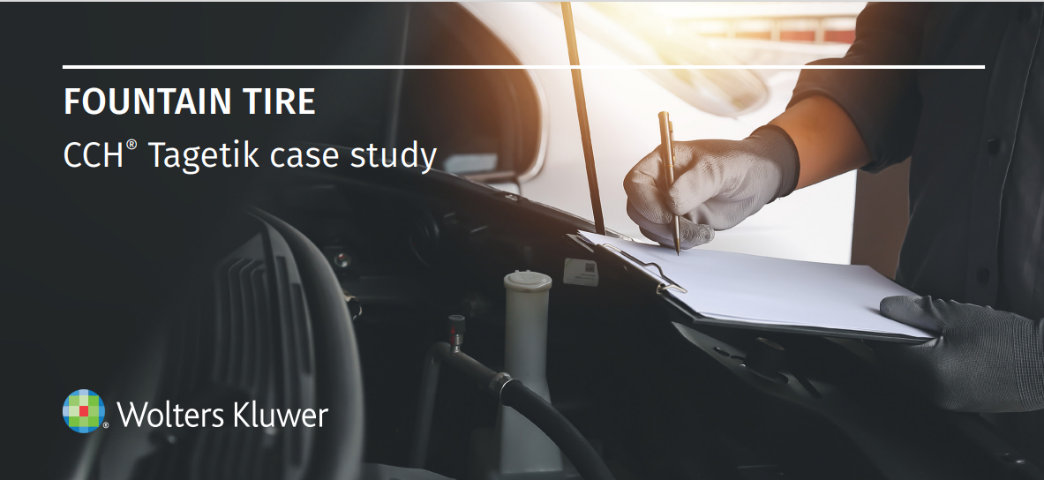
Fountain Tire Grows Forecast Accuracy by 15%
CCH® Tagetik processes: Supply Chain Planning
CHALLENGES
CCH® TAGETIK SOLUTIONS
RESULTS
Fountain Tire, a Canadian tire dealer and automotive service provider, was experiencing unexpected spikes in demand, SKU proliferation, and overall business expansion.
Their forecasting methods couldn’t keep pace with growth, were prone to error, and resulted in stock outs that forced customers to buy their products from third parties.
Fountain Tire implemented CCH® Tagetik Supply Chain Planning for Demand and Supply Planning and began modeling scenarios to reach accurate baseline forecasts for each product.
Using a combination of historical data and predictive forecast methods, they developed plans that ensured enough safety stock for prioritized SKUs at each of their warehouses.
Platform automations allowed them to easily roll each SKU-level forecast up to the warehouse level.
With CCH® Tagetik Supply Chain Planning, Fountain Tire achieved rapid growth due in part to the dramatic improvement in the ability to prepare forecasts. They saw:
15% Improved forecast accuracy
Reduced third-party purchases by 9%
Reduced supply chain related costs
Reduced Response Time
"With stronger forecasts and better replenishment capabilities, we’ve seen less off-program and third-party purchases as well as improved stock levels."
Ken Miller, Director of Inventory, Fountain Tire
READ THE CASE STUDY

Slide 11
Customers’ Voice
“With CCH Tagetik, our budgeting and forecasting cycles have become much faster, and the accuracy of our forecasts has improved significantly. One of the main reasons is that the software provides a single source of truth, integrating data seamlessly from the initial input through to our reporting. This structure—from the ground-level templates to the comprehensive reporting packages—lets us aggregate and report data efficiently, supporting clear and accurate decision-making across the board.”
Josh Issertell - Financial Planning & Analysis Manager, American Crystal Sugar Co.
One of the biggest changes we've seen is the efficiency gained through standardization. Previously, our FP&A teams used individual forms and reports, consuming a lot of time to maintain them. With CCH Tagetik, we’ve standardized input forms and reports, giving analysts more time to focus on adding value to FP&A.”
Jake Hester - Sr. Manager, FP&A, Fluor Corporation
The transformation we experienced was significant. CCH Tagetik allowed us to move away from manual spreadsheets and ad hoc analysis to a more integrated, data-driven approach. Our forecasting, planning, and replenishment processes have all improved, driving efficiency and providing real, actionable insights.”
Randy W. Peters - Director of Supply Chain, Pipeline Packaging

Slide 12
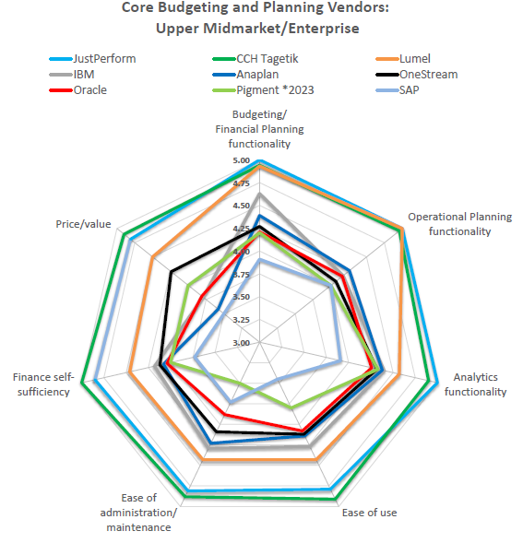
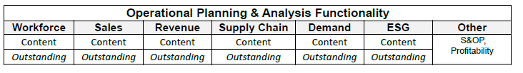
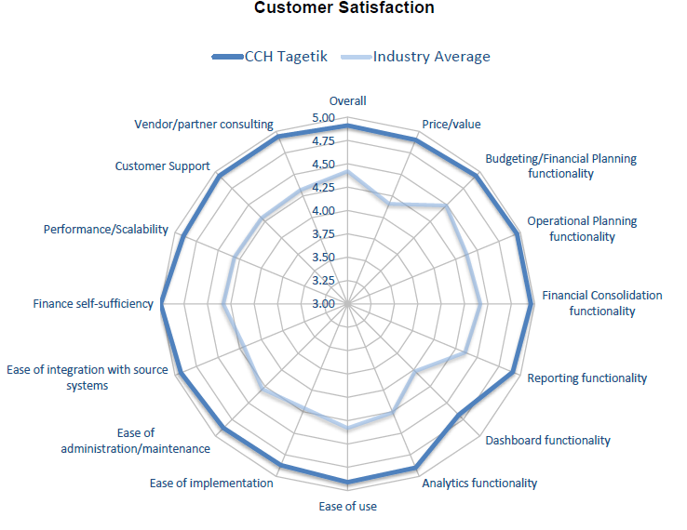
Analyst Validation & Leadership
BPM Partners 2025 Buyers’ Guide for Budgeting, Planning & Forecasting Solutions
BPM Partners Vendor Landscape Matrix – 2024/2025 Edition

Slide 13
Common Questions & Competitive FUD
CCH Tagetik uses MDX for their calculations
MDX scripting was used 10+ years ago in CCH Tagetik. CCH Tagetik planning models use built-in functionality as much as possible (i.e. Capex Planning, HR Planning, BC & CF Planning all have out-of-the box functionality). For the most unique calculation requirements (usually in the world of Sales & Revenue planning which vary greatly company by company), we used a low-code approach leveraging common SQL scripting language.
CCH Tagetik does not provide pre-built planning templates
CCH Tagetik intentionally avoids rigid, pre-built templates to provide greater flexibility and adaptability. Instead of forcing customers into predefined models, we offer a scalable data model and comprehensive toolset that adapt to unique business needs. Pre-built templates often require businesses to adjust their processes to fit the software. With CCH Tagetik, organizations retain control over their planning models, ensuring alignment with their industry, workflows, and strategic priorities. Our platform also includes best-practice frameworks and accelerators, offering guidance while preserving customization. This approach future-proofs planning, eliminating costly workarounds and ensuring scalability as needs evolve.
It is very hard to build and maintain planning models in CCH Tagetik
CCH Tagetik is an enterprise-grade planning solution, built to handle the complexity of large-scale financial and operational planning—not just a simple departmental tool. Enterprise planning requires flexibility, scalability, and governance, which naturally introduces a level of sophistication that ensures accuracy, control, and adaptability across the organization.

Slide 14
Planning
Strengths & Weaknesses
Strengths | Weaknesses
Strong enterprise grade / corporate level planning capabilities | On-the-fly Modeling
AIH allows for sophisticated modeling requirements at the local level | What if / scenario planning
High governance of the overall planning process | Lack of predefined/industry templates
Scalability for granular level of operational details | AI capabilities not fully productized yet within the solution
Strong AI capabilities as a service to other modules
Sophisticated Cash Flow Planning Capabilities

Slide 15
Thank You

